Slide 1
PB HACKATHON
IoT Environment Monitor
with Threshold Alerts
Software-Simulated ESP32 Prototype
Student 1: __________________________
Student 2: __________________________
Student 3: __________________________
Student 4: __________________________
CSIT • REVA University

Slide 2
1. Problem Statement
PB HACKATHON
• Environmental conditions can change quickly and may go unnoticed.
• Manual monitoring does not provide continuous real-time information.
• A sudden rise in temperature or humidity can require immediate attention.
• An automated monitoring system can detect abnormal conditions and generate alerts.
Challenge
How can we continuously monitor the environment and warn users when safe limits are exceeded?
Goal
Build a low-cost, software-simulated IoT prototype that detects threshold violations automatically.
Key Idea
Sense → Process → Compare → Alert
PB HACKATHON • IoT Environment Monitor | 2

Slide 3
2. Proposed Solution
PB HACKATHON
DHT22
ESP32
Threshold Logic
Alert
Temperature
+ Humidity
Read & process
data
Compare with
safe limits
LED + Buzzer
The system continuously reads sensor data and automatically changes from NORMAL to ALERT when a threshold is exceeded.
PB HACKATHON • IoT Environment Monitor | 3

Slide 4
3. Components & Tools
PB HACKATHON
ESP32
DHT22
LED
Main microcontroller used to read the sensor and control alerts.
Simulated temperature and humidity sensor.
Visual warning when a threshold is exceeded.
Buzzer
Wokwi
Arduino C/C++
Audio warning for abnormal conditions.
Online simulator used to build and test the prototype.
Program used for sensor reading and threshold logic.
PB HACKATHON • IoT Environment Monitor | 4

Slide 5
4. System Architecture
PB HACKATHON
DHT22
Sensor
ESP32
Controller
Threshold
Checking
LED + Buzzer
Alert
Temperature threshold
Humidity threshold
> 35°C → ALERT
> 80% → ALERT
PB HACKATHON • IoT Environment Monitor | 5

Slide 6
5. Working Principle
PB HACKATHON
• DHT22 provides temperature and humidity readings.
• ESP32 reads the values every few seconds.
• The program compares readings with predefined thresholds.
• If all values are within limits, the system shows NORMAL.
• If a limit is exceeded, the LED and buzzer are activated.
NORMAL
25°C + 40% humidity
→ 🟢 STATUS: NORMAL
ALERT
38°C + 40% humidity
→ 🔴 STATUS: ALERT!
→ LED + Buzzer ON
PB HACKATHON • IoT Environment Monitor | 6

Slide 7
6. Program Logic
PB HACKATHON
Read temperature
Read humidity
if (temperature > 35°C
OR humidity > 80%):
LED = ON
Buzzer = ON
STATUS = ALERT
else:
LED = OFF
Buzzer = OFF
STATUS = NORMAL
Current limits
Temperature: 35°C
Humidity: 80%
Outputs
LED: GPIO 2
Buzzer: GPIO 4
Sensor
DHT22: GPIO 15
PB HACKATHON • IoT Environment Monitor | 7

Slide 8
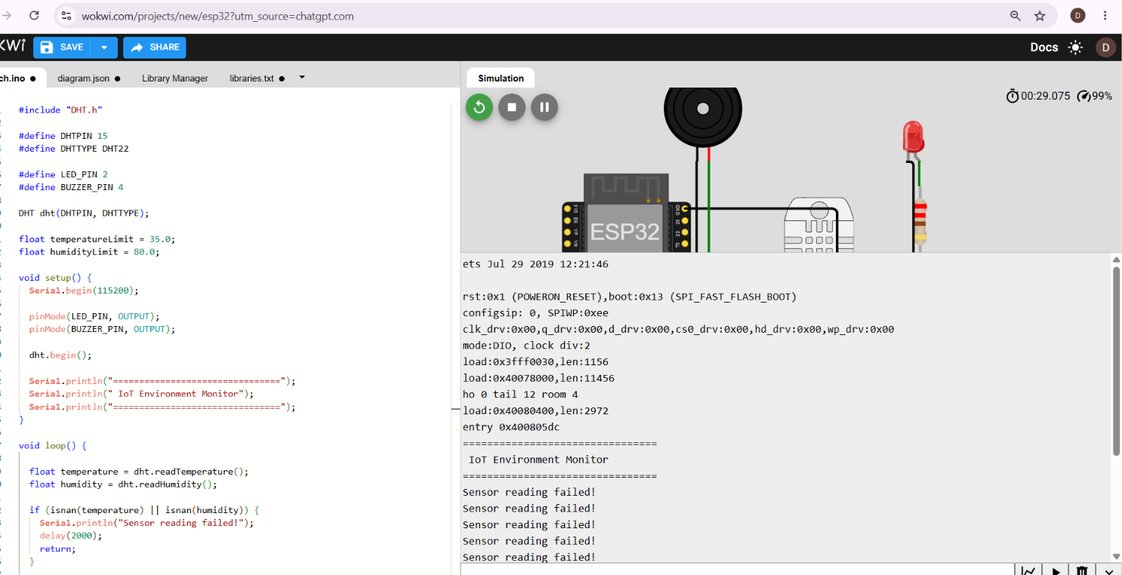
7. Simulation & Result
PB HACKATHON
Normal Mode
Sensor values below limits
🟢 LED OFF
🔇 Buzzer OFF
Alert Mode
Temperature raised to 38°C
🔴 LED ON
🔊 Buzzer ON
Result
Threshold alert verified
PB HACKATHON • IoT Environment Monitor | 8

Slide 9
8. Benefits & Applications
PB HACKATHON
Benefits
Future Scope
Continuous monitoring • Fast alerts • Low-cost prototype • Easy to expand
• Add air-quality monitoring using MQ-135
• Cloud/IoT dashboard
• Mobile notifications
• Historical graphs and data logging
• More environmental sensors
• AI-based prediction and anomaly detection
Smart Spaces
Classrooms • Offices • Homes • Laboratories
Safety
Helps users notice abnormal environmental conditions quickly.
PB HACKATHON • IoT Environment Monitor | 9

Slide 10
9. Conclusion
The project demonstrates a practical IoT approach to environmental monitoring.
The ESP32 continuously processes sensor data and provides an immediate LED and buzzer alert when safe thresholds are exceeded.
Thank You
Questions & Discussion

